Slide 1

Artist presentation – Nam June paik
Des Inv 23 – Summer 2020

Slide 2
Who is nam June paik?
Nam June Paik (1932–2006)
the ​“Father of Video Art”
Born in 1932 in Seoul, Korea, to a wealthy industrial family. He was trained as a pianist.
Paik and his family fled Korea in 1950 at the outset of the Korean War, first to Hong Kong, then to Japan. Finally, he immigrated to and settled in the United States in 1964.
the University of Tokyo – B.S. in Asthetics – 1956; Munich University (West Germany) - study music history with composer Thrasybulos Georgiades
Notes:
Nam June Paik (1932–2006), internationally recognized as the ​“Father of Video Art,” created a large body of work including video sculptures, installations, performances, videotapes and television productions. He had a global presence and influence, and his innovative art and visionary ideas continue to inspire a new generation of artists.
Born in 1932 in Seoul, Korea, to a wealthy industrial family, Paik and his family fled Korea in 1950 at the outset of the Korean War, first to Hong Kong, then to Japan. Paik graduated from the University of Tokyo in 1956, and then traveled to Germany to pursue his interest in avant-garde music, composition and performance. There he met John Cage and George Maciunas and became a member of the neo-dada Fluxus movement. In 1963, Paik had his legendary one-artist exhibition at the Galerie Parnass in Wuppertal, Germany, that featured his prepared television sets, which radically altered the look and content of television.
After immigrating to the United States in 1964, he settled in New York City where he expanded his engagement with video and television, and had exhibitions of his work at the New School, Galerie Bonino and the Howard Wise Gallery. In 1965, Paik was one of the first artists to use a portable video camcorder. In 1969, he worked with the Japanese engineer Shuya Abe to construct an early video-synthesizer that allowed Paik to combine and manipulate images from different sources. The Paik-Abe video synthesizer transformed electronic moving-image making. Paik invented a new artistic medium with television and video, creating an astonishing range of artworks, from his seminal videotape Global Groove (1973) that broke new ground, to his sculptures TV Buddha (1974), and TV Cello (1971); to installations such as TV Garden (1974), Video Fish (1975) and Fin de Siecle II (1989); videotapes Living with the Living Theatre (1989) and Guadalcanal Requiem (1977÷1979); and global satellite television productions such as Good Morning Mr. Orwell, which broadcast from the Centre Pompidou in Paris and a WNET-TV studio in New York City Jan. 1, 1984.
Paik has been the subject of numerous exhibitions, including two major retrospectives, and has been featured in major international art exhibitions including Documenta, the Venice Biennale and the Whitney Biennial. The Nam June Paik Art Center opened in a suburb of Seoul, South Korea, in 2008.
Smithsonian American Art Museum ​“The Smithsonian American Art Museum Acquires the Complete Estate Archive of Visionary Artist Nam June Paik” (Washington, D.C.: Smithsonian American Art Museum, press release, May 1, 2009)

Slide 3
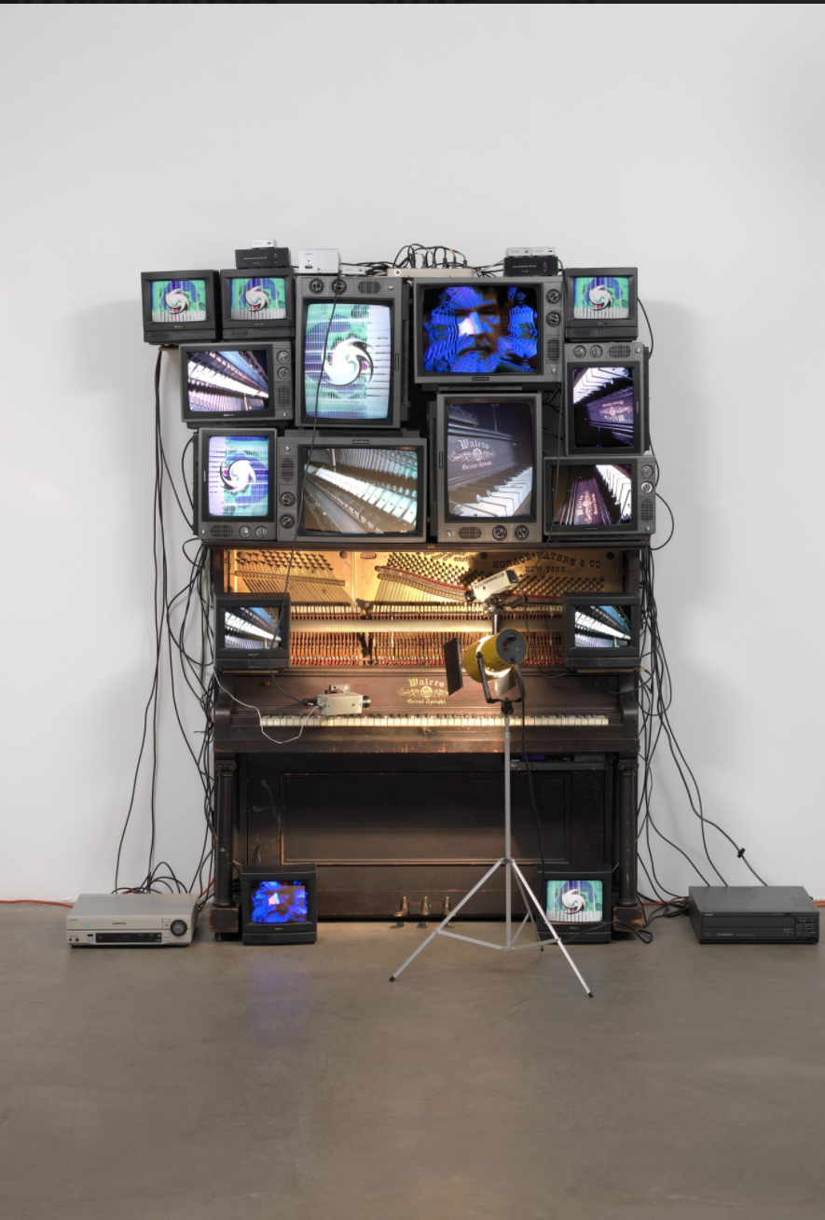
Untitled (1993)
“I think I understand time better than the video artists who came from painting-sculpture […] music is the manipulation of time […] As painters understand abstract space, I understand abstract time” – Paik
https://www.youtube.com/watch?v=opug8uW21eU
An piano is wired with 15 TV screens. Small closed-circuit cameras trained on the instrument's mechanism are wired to the set. A sthe piano plays unmanned, its workings appear on the screens
The image of John Cage, an influential artist at the time whom Paik met in Germany, is displayed on one monitor at the sculpture's top and on another at its foot
Notes:
We also see, on one monitor at the sculpture's top and on another at its foot, the image of the late John Cage. A composer and aesthetic thinker who embraced chance, accident, and a certain playfulness of approach, Cage was influential for many postwar artists, including Paik.

Slide 4
TV Garden (1974)
A large-scale installation consisting of forty television sets lying on the floor amidst many tropical plants while a video of Global Groove plays on the screens of the TV sets.
Global groove: https://youtu.be/xnCF5smgXXA

Slide 6
Electronic Superhighway: Continental U.S., Alaska, Hawaii (1995)
Currently displayed in the Smithsonian American Art Museum
Paik was the first to use the phrase ​“electronic superhighway”
the interstate highway system <-> electronic super highway“ -> see the U.S.A. in your Chevrolet.”
Metaphors in this piece:
length of this installation - the enormous scale of the nation
Neon outlines the monitors - multicolored maps and glowing enticements of motels and restaurants that beckoned Americans to the open road.
Different colors - individual states still have distinct identities and cultures, even in today’s information age
Flashing images - ​“seen as though from a passing car”; video clips are chosen based on relevance of it to each state = our picture of America has always been influenced by film and television.
https://www.youtube.com/watch?v=9QHrw9Nr0jc
Notes:
when Nam June Paik came to the United States in 1964, the interstate highway system was only nine years old, and superhighways offered everyone the freedom to ​“see the U.S.A. in your Chevrolet.” Walking along the entire length of this installation suggests the enormous scale of the nation that confronted the young Korean artist when he arrived. Neon outlines the monitors, recalling the multicolored maps and glowing enticements of motels and restaurants that beckoned Americans to the open road. The different colors remind us that individual states still have distinct identities and cultures, even in today’s information age.Paik augmented the flashing images ​“seen as though from a passing car” with audio clips from The Wizard of Oz, Oklahoma, and other screen gems, suggesting that our picture of America has always been influenced by film and television. Today, the Internet and twenty-four-hour broadcasting tend to homogenize the customs and accents of what was once a more diverse nation. Paik was the first to use the phrase ​“electronic superhighway,” and this installation proposes that electronic media provide us with what we used to leave home to discover. But Electronic Superhighway is real. It is an enormous physical object that occupies a middle ground between the virtual reality of the media and the sprawling country beyond our doors

Slide 7
Untitled (2005)
plaster man with Sony Watchman head)

Slide 8
Megatron/​Matrix (1995)
“Our life is half natural and half technological. Half-and-half is good. You cannot deny that high-tech is progress. We need it for jobs. Yet if you make only high-tech, you make war. So we must have a strong human element to keep modesty and natural life.”
-Nam June Paik
https://www.youtube.com/watch?v=ZHGS42Hl95U

Slide 9
Megatron Matrix is approximately the size of a giant billboard and holds 215 monitor screens, placed together side by side with no space between them.
Video feed:
mixed images from the Seoul Olympics with Korean folk rituals and modern dance
smaller videos or images play simultaneously on multiple monitors and forming a big picture - crossing the boundaries of each screen.
Moving patterns, color effects and rhythm are created by timing the videos perfectly.
Audio: unrelated sound bites, including some from the Olympics, electronic sound effects and electronic music
Meaning of the piece: a world without borders in the electronic age; excess of information can be uncomfortable

